Slide 1
Intensity Transformation and Spatial Filtering

Slide 2
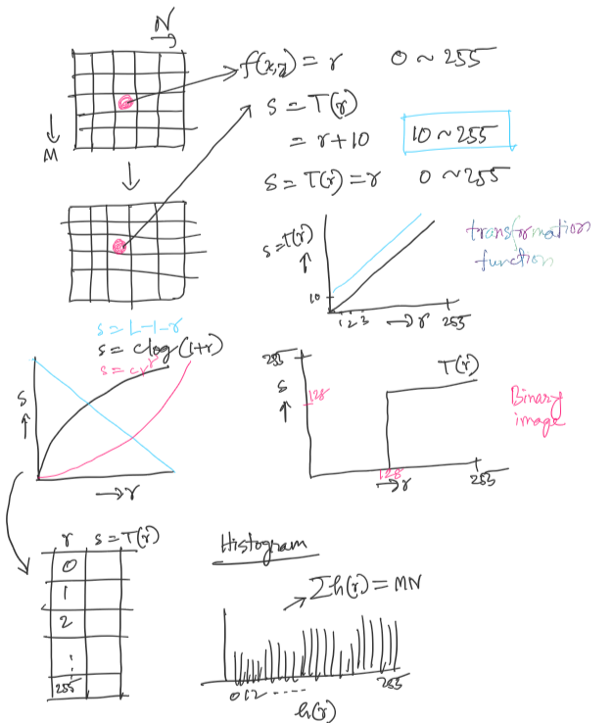
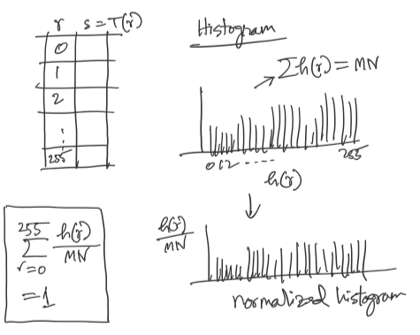

Slide 3
Spatial Domain Process

Slide 4
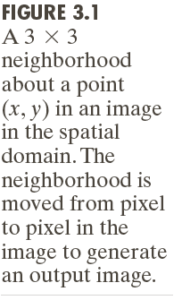
Spatial Domain Process

Slide 5
Spatial Domain Process

Slide 6
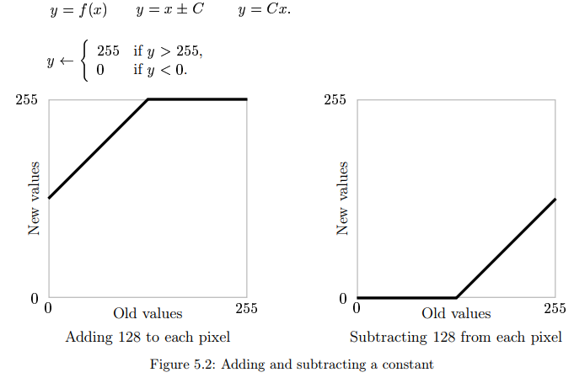
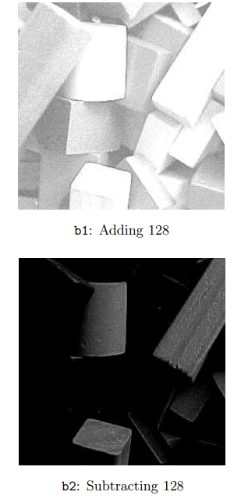
Arithmetic operations and clipping

Slide 7
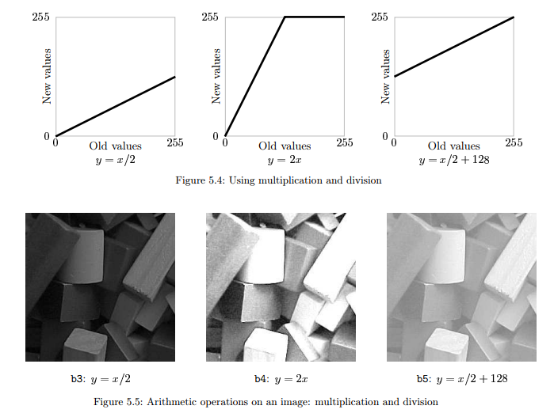
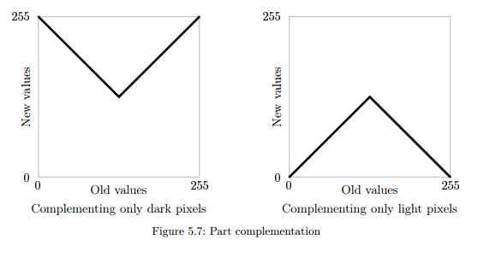

Slide 8
Some Basic Intensity Transformation Functions

Slide 9
Image Negatives

Slide 10
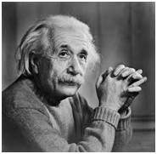
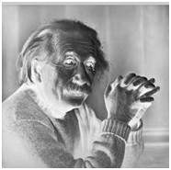
Example: Image Negatives

Slide 11
Log Transformations

Slide 12
Example: Log Transformations

Slide 13
Power-Law (Gamma) Transformations

Slide 14
Example: Gamma Transformations

Slide 15
Example: Gamma Transformations
Cathode ray tube (CRT) devices have an intensity-to-voltage response that is a power function, with exponents varying from approximately 1.8 to 2.5

Slide 16
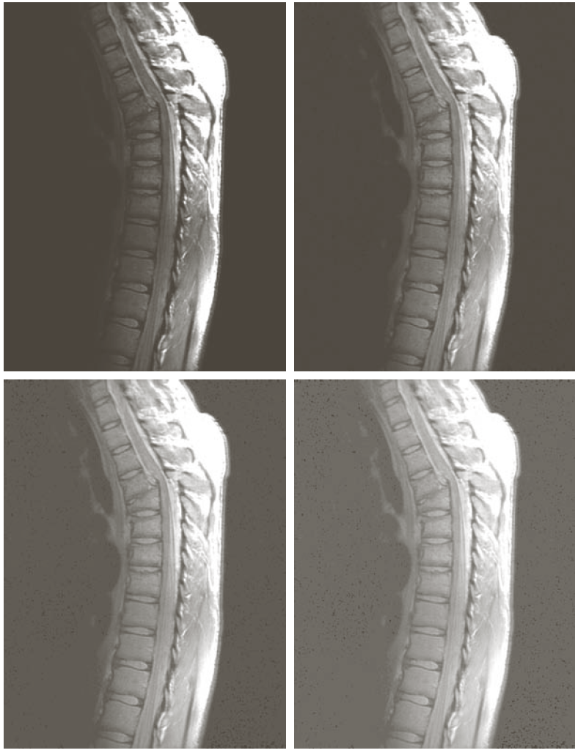

Example: Gamma Transformations

Slide 17
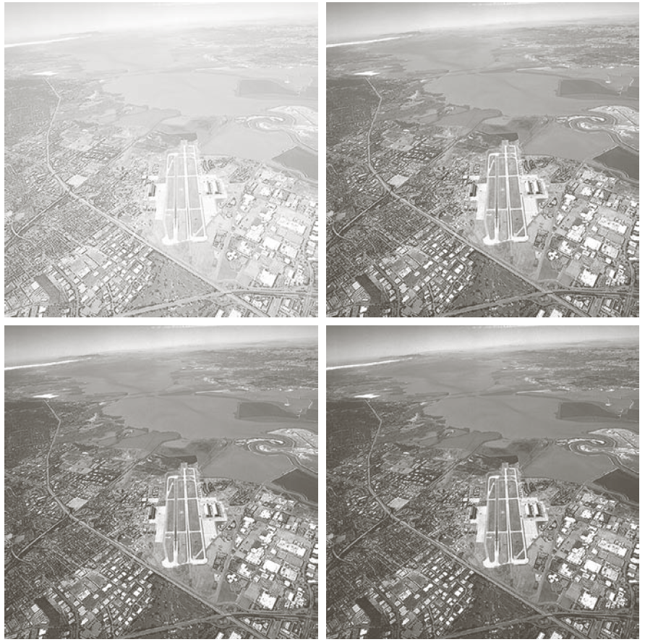
Example: Gamma Transformations

Slide 18
Piecewise-Linear Transformations
Contrast Stretching
— Expands the range of intensity levels in an image so that it spans the full intensity range of the recording medium or display device.
Intensity-level Slicing
— Highlighting a specific range of intensities in an image often is of interest.
output = output_start + ((output_end - output_start) / (input_end - input_start)) * (input - input_start)

Slide 20
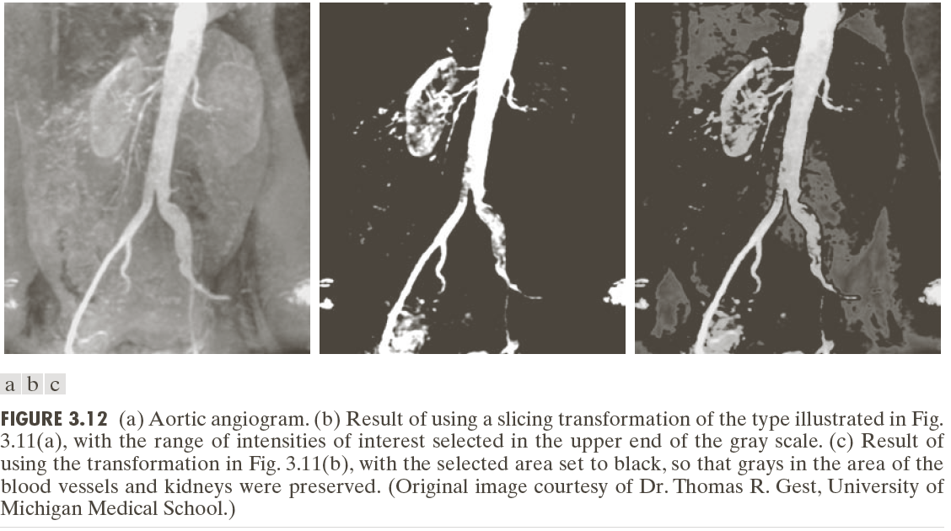
Highlight the major blood vessels and study the shape of the flow of the contrast medium (to detect blockages, etc.)
Measuring the actual flow of the contrast medium as a function of time in a series of images

Slide 21
Bit-plane Slicing

Slide 22
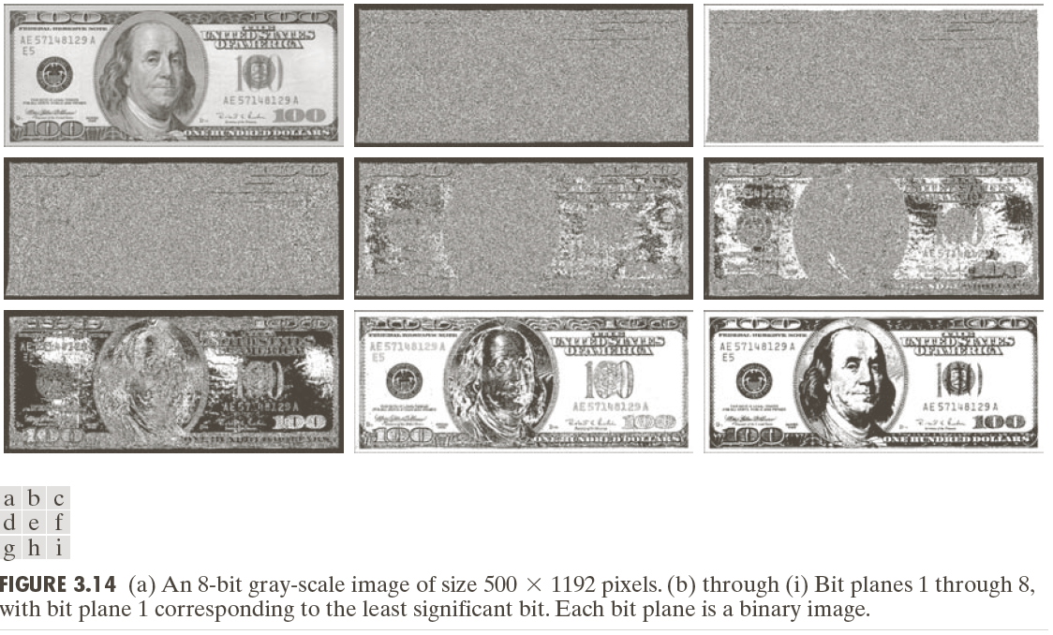
Bit-plane Slicing

Slide 23
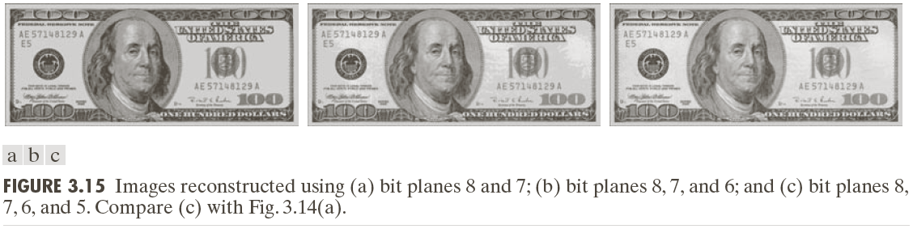
Bit-plane Slicing

Slide 24
Merging two images
M = top (mask) image, I = lower image
E = M + I
Multiply, E = M x I/ 255
Screen, E = 255 – ((255 - M) x (255 - I)) / 255
Overlay, E = (I / 255) x (I + (2xM/255) x (255 - I))
Dodge, E = 256 x I / ((255 - M) + 1)
Burn, E = 255 – (256 x (255- I) / (M + 1))
For more https://docs.gimp.org/en/gimp-concepts-layer-modes.html
https://en.wikipedia.org/wiki/Blend_modes
https://es.mathworks.com/matlabcentral/fileexchange/43122-blend-images

Slide 25
Assignment#1 Discussion
Posterize: Usually values within [0,255] represent a pixel. Instead of using 256 colors, you have to use less number of colors like 4-8. Every pixel will get the closest output color.
Nightvision: Output R = Input G / 2, Output B = 2 x Output R, Output G = 2 x Output B
Photocopy: Convert the input to gray level image. Then, consider a threshold = 100. If a pixel value is greater than the threshold, put 255 as the color value in the output. Otherwise, put input pixel x (threshold - input pixel) / (threshold^2) as the output pixel.
Vignetting: Calculate the center pixel of the image and the maximum distance (M) possible from the center to any corner. Then, go to each pixel and calculate the distance (D) from that pixel location to the center. Find a darkness weight = 1 - D / M. For the output pixel, multiply the weights with the input pixel value.
Mirror Image: We can get the mirror image of the given image if we reverse the order of the pixels (elements of the matrix) in each row.

Slide 26
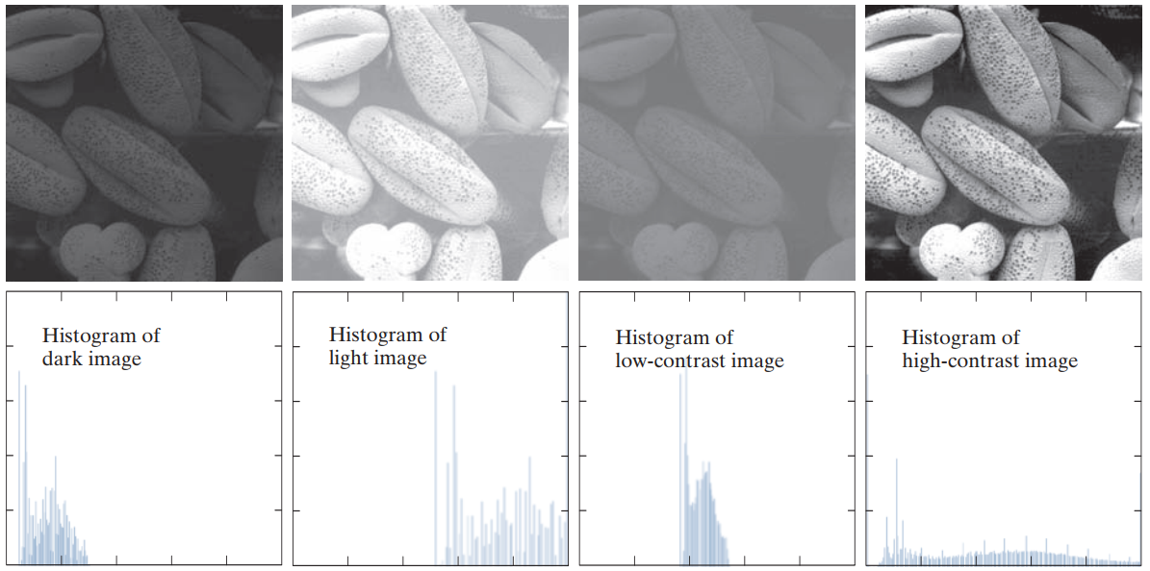

Slide 27
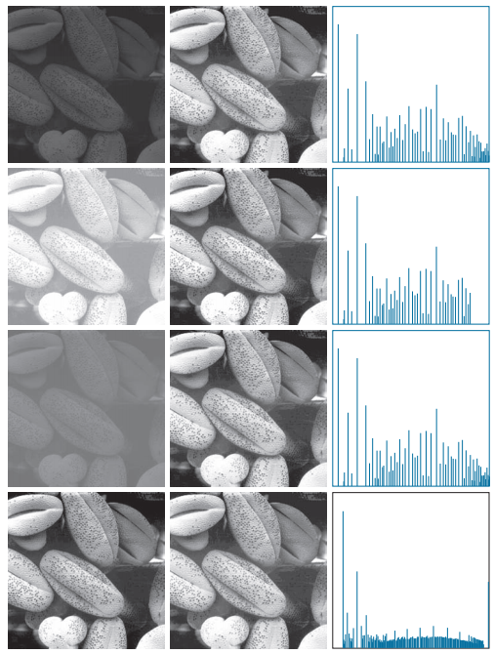
Histogram Equalization

Slide 28
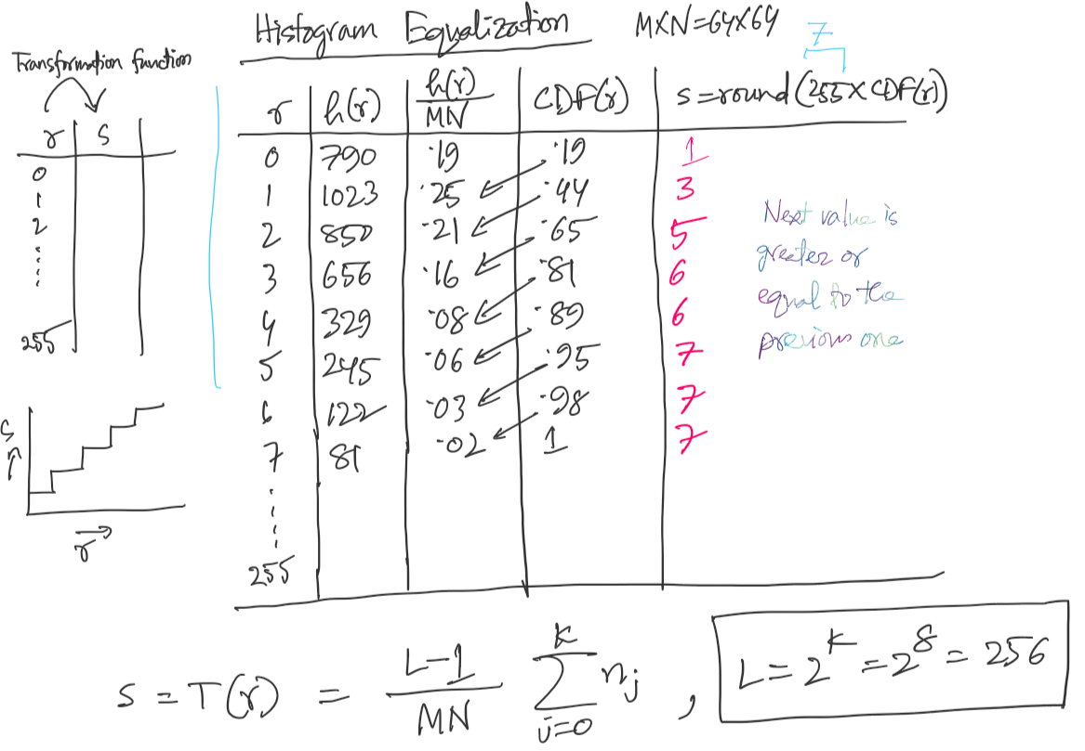

Slide 29
Histogram Equalization

Slide 30
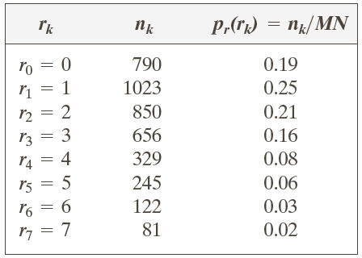
Example: Histogram Equalization
Suppose that a 3-bit image (L=8) of size 64 × 64 pixels (MN = 4096) has the intensity distribution shown in following table.
Get the histogram equalization transformation function and give the p_{s}(s_{k}) for each s_{k}.

Slide 31
Example: Histogram Equalization

Slide 32
Example: Histogram Equalization

Slide 33
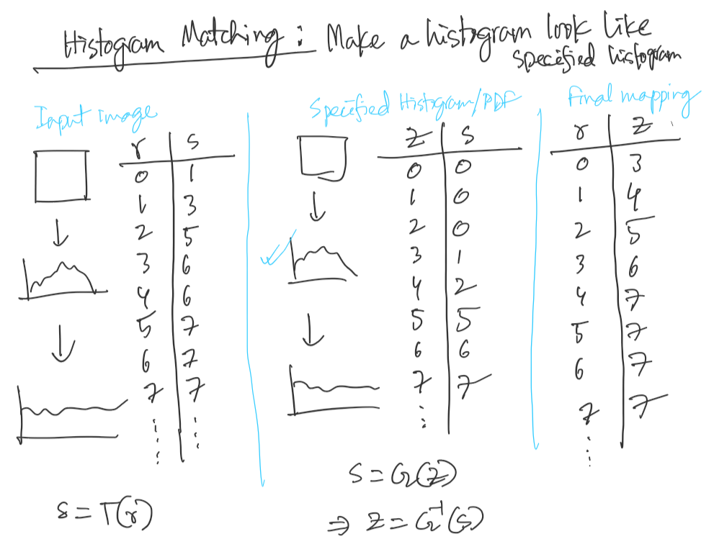

Slide 34
Histogram Matching: Discrete Cases
Obtain p_{r}(r_{j}) from the input image and then obtain the values of s_{k}, round the value to the integer range [0, L-1].
Use the specified PDF and obtain the transformation function G(z_{q}), round the value to the integer range [0, L-1].
Mapping from s_{k} to z_{q}

Slide 35
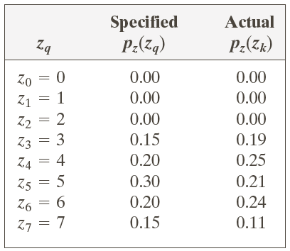
Example: Histogram Matching
Suppose that a 3-bit image (L=8) of size 64 × 64 pixels (MN = 4096) has the intensity distribution shown in the following table (on the left). Get the histogram transformation function and make the output image with the specified histogram, listed in the table on the right.

Slide 36
Example: Histogram Matching
Obtain the scaled histogram-equalized values,
Compute all the values of the transformation function G,

Slide 37
Example: Histogram Matching

Slide 38
Example: Histogram Matching
Obtain the scaled histogram-equalized values,
Compute all the values of the transformation function G,
s₀
s₁
s₂
s₃
s₄
s₅
s₆
s₇

Slide 39
Example: Histogram Matching

Slide 40
Example: Histogram Matching
Further readining:
https://automaticaddison.com/difference-between-histogram-equalization-and-histogram-matching/

Slide 41
Example: Histogram Matching

Slide 42
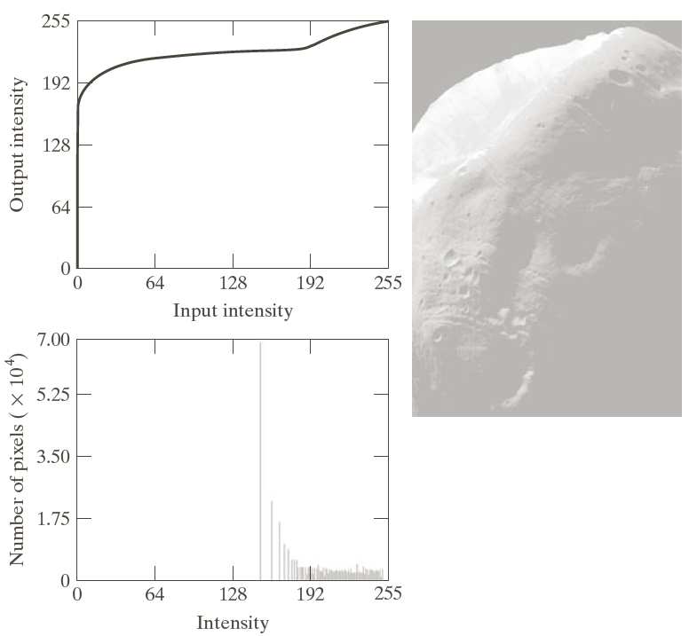
Example: Histogram Matching

Slide 43
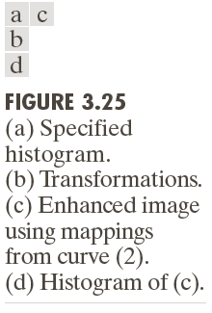
Example: Histogram Matching

Slide 44
Local Histogram Processing
Define a neighborhood and move its center from pixel to pixel
At each location, the histogram of the points in the neighborhood is computed. Either histogram equalization or histogram specification transformation function is obtained
Map the intensity of the pixel centered in the neighborhood
Move to the next location and repeat the procedure

Slide 45
Local Histogram Processing: Example

Slide 46
Spatial Filtering
A spatial filter consists of (a) a neighborhood, and (b) a predefined operation
Linear spatial filtering of an image of size MxN with a filter of size mxn is given by the expression

Slide 47
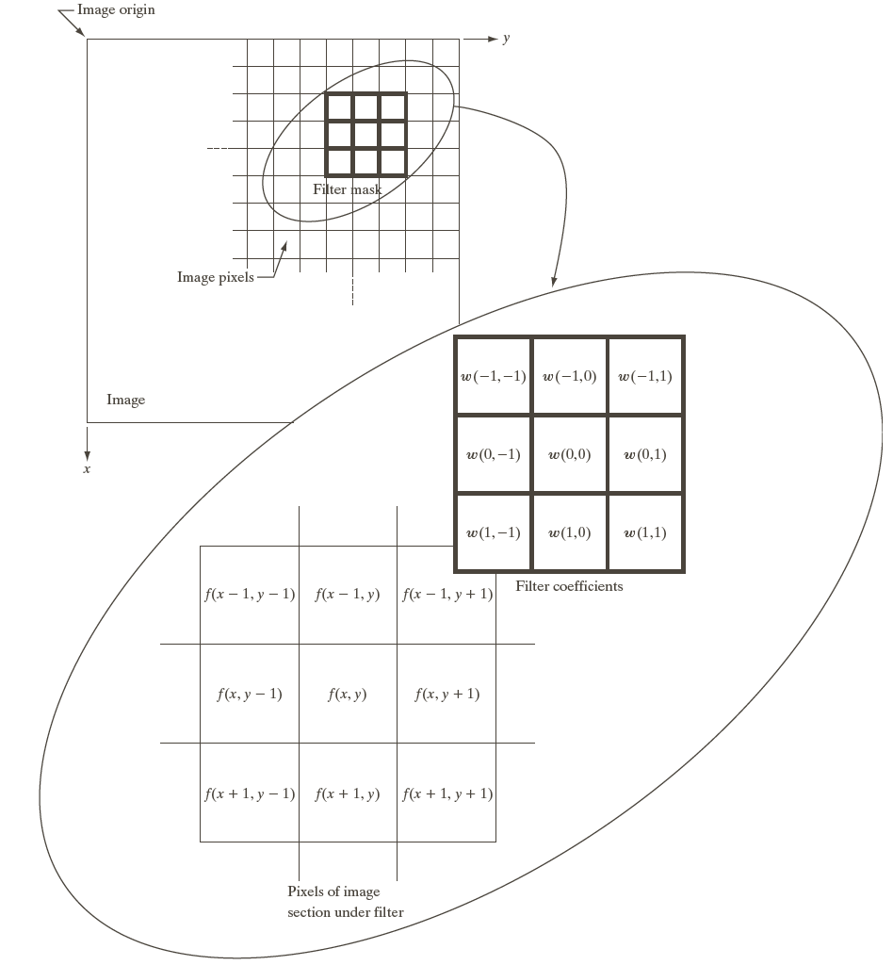
Spatial Filtering

Slide 48
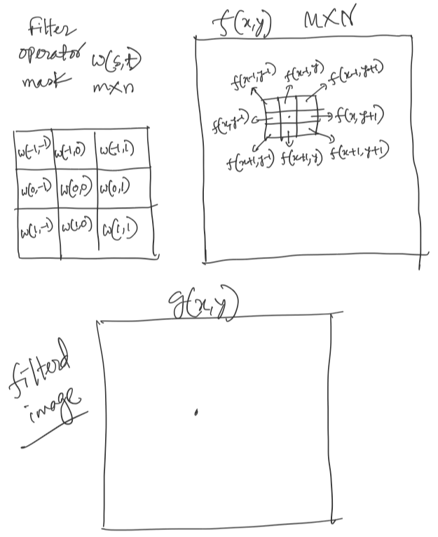
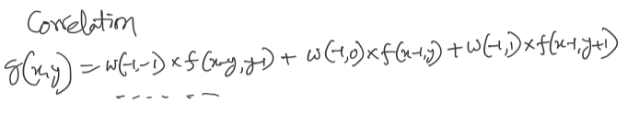

Slide 49
Spatial Correlation

Slide 50
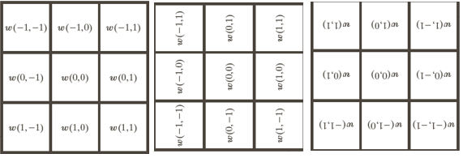
Spatial Convolution

Slide 51
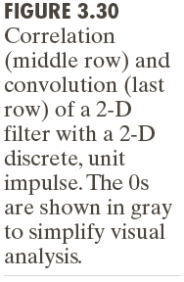

Slide 52
Smoothing Spatial Filters
Smoothing filters are used for blurring and for noise reduction
Blurring is used in removal of small details and bridging of small gaps in lines or curves
Smoothing spatial filters include linear filters and nonlinear filters.

Slide 53
Spatial Smoothing Linear Filters

Slide 54
Two Smoothing Averaging Filter Masks

Slide 56
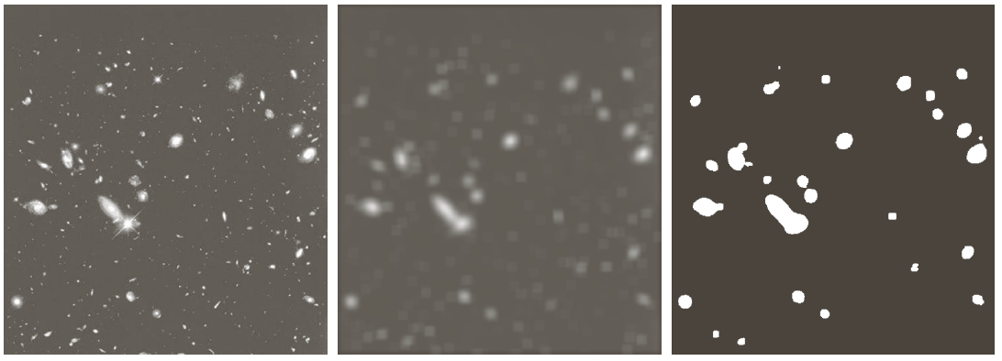
Example: Gross Representation of Objects

Slide 57
Order-statistic (Nonlinear) Filters
— Nonlinear
— Based on ordering (ranking) the pixels contained in the filter mask
— Replacing the value of the center pixel with the value determined by the ranking result
E.g., median filter, max filter, min filter

Slide 58
Example: Use of Median Filtering for Noise Reduction

Slide 59
Sharpening Spatial Filters
Foundation
Laplacian Operator
Unsharp Masking and Highboost Filtering
Using First-Order Derivatives for Nonlinear Image Sharpening — The Gradient

Slide 60
Sharpening Spatial Filters: Foundation
The first-order derivative of a one-dimensional function f(x) is the difference
The second-order derivative of f(x) as the difference

Slide 61
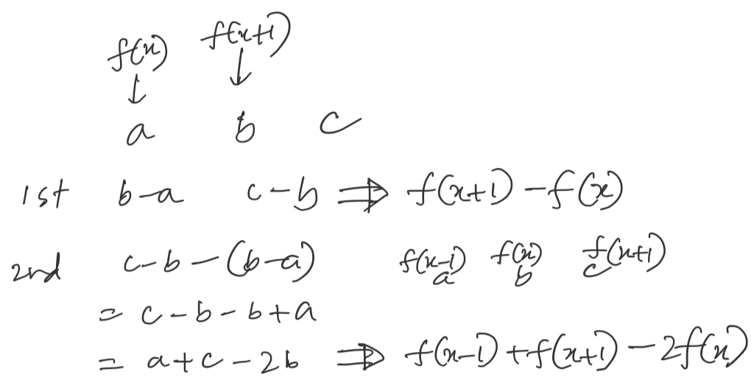

Slide 62
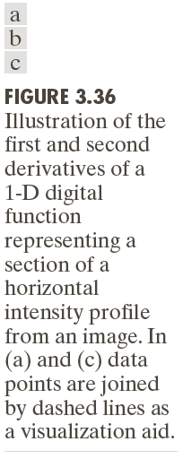

Slide 63
Sharpening Spatial Filters: Laplace Operator
The second-order isotropic derivative operator is the Laplacian for a function (image) f(x,y)

Slide 64
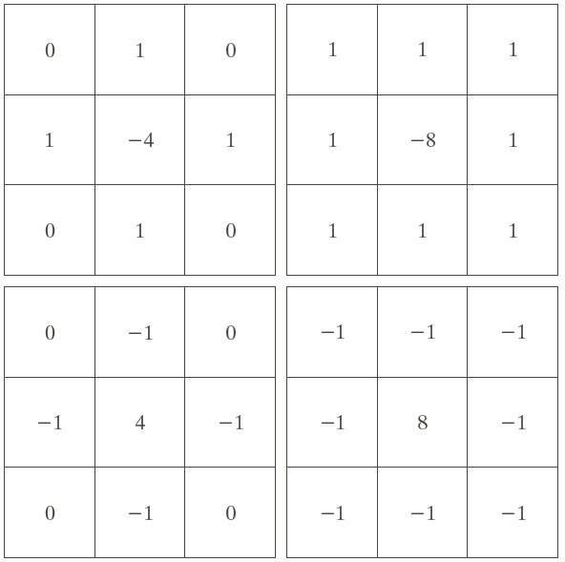
Sharpening Spatial Filters: Laplace Operator

Slide 65
Sharpening Spatial Filters: Laplace Operator
Image sharpening in the way of using the Laplacian:

Slide 66
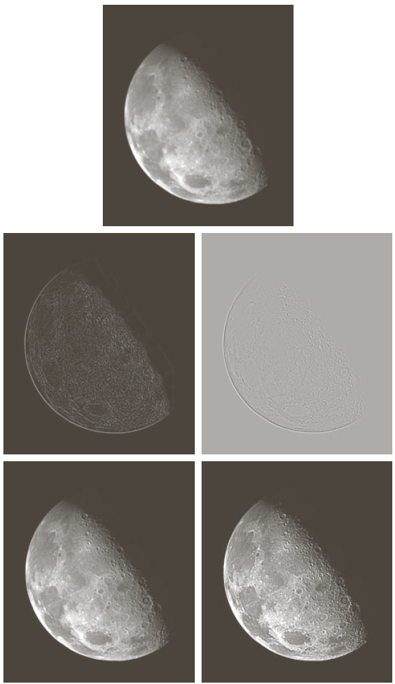

Slide 67
Unsharp Masking and Highboost Filtering
Unsharp masking
Sharpen images consists of subtracting an unsharp (smoothed) version of an image from the original image
e.g., printing and publishing industry
Steps
1. Blur the original image
2. Subtract the blurred image from the original
3. Add the mask to the original

Slide 68
Unsharp Masking and Highboost Filtering

Slide 69
Unsharp Masking: Demo

Slide 70
Unsharp Masking and Highboost Filtering: Example

Slide 71
Image Sharpening based on First-Order Derivatives
Gradient Image

Slide 72
Image Sharpening based on First-Order Derivatives
z₁ | z₂ | z₃
z₄ | z₅ | z₆
z₇ | z₈ | z₉

Slide 73
Image Sharpening based on First-Order Derivatives
z₁ | z₂ | z₃
z₄ | z₅ | z₆
z₇ | z₈ | z₉

Slide 74
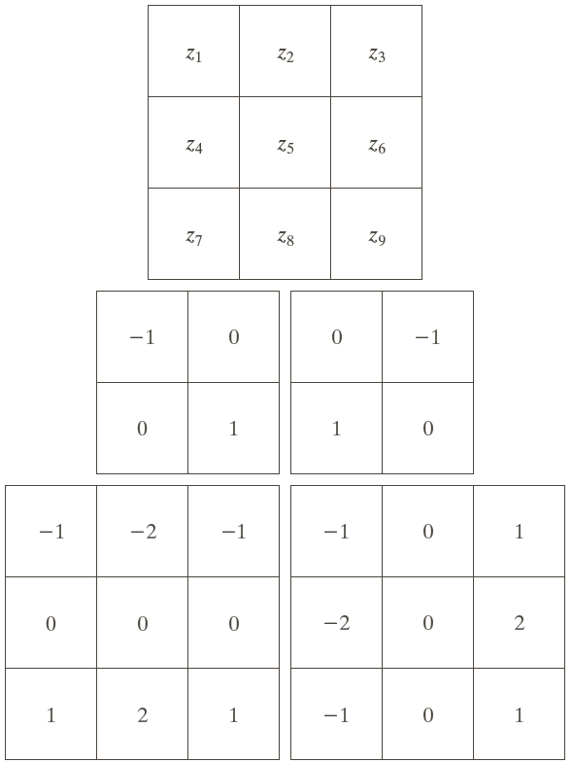
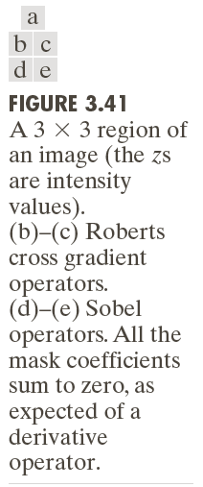
Image Sharpening based on First-Order Derivatives

Slide 75
Example

Slide 76
Example: Combining Spatial Enhancement Methods Goal: Enhance the image by sharpening it and by bringing out more of the skeletal detail

Slide 77
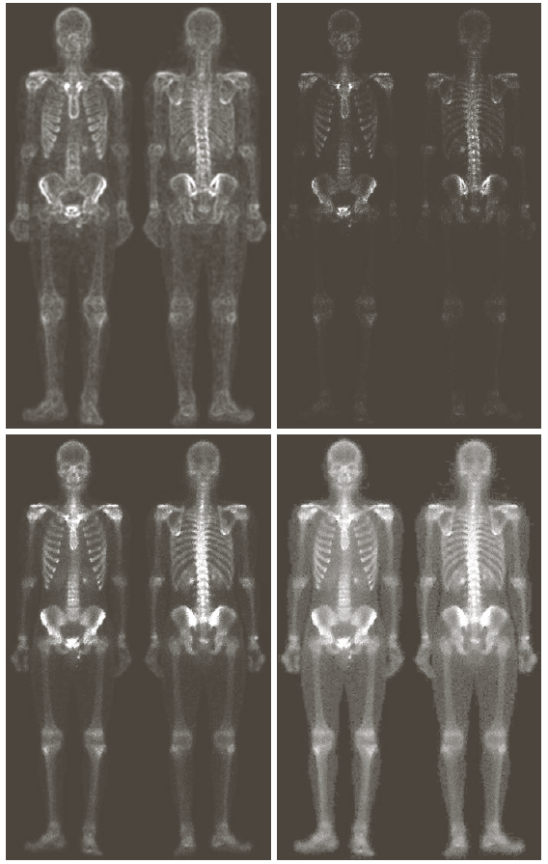
Example: Combining Spatial Enhancement Methods Goal: Enhance the image by sharpening it and by bringing out more of the skeletal detail

Slide 78
Blurring masks
A blurring mask has the following properties.
All the values in blurring masks are positive
The sum of all the values is equal to 1
The edge content is reduced by using a blurring mask
As the size of the mask grow, more smoothing effect will take place
Derivative masks
A derivative mask has the following properties.
A derivative mask have positive and as well as negative values
The sum of all the values in a derivative mask is equal to zero
The edge content is increased by a derivative mask
As the size of the mask grows , more edge content is increased
Blurring masks are also called as low pass filter
Derivative masks are also called as high pass filter

Slide 79
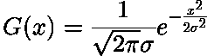
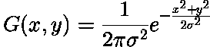
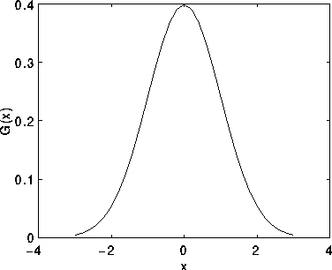
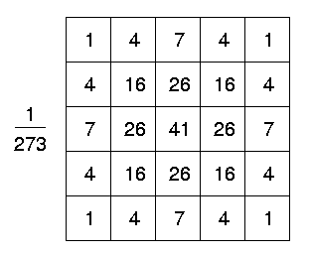
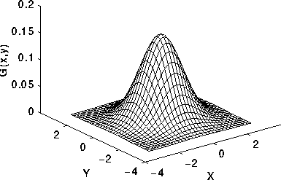
Gaussian Smoothing/Blur
The Gaussian distribution in 1-D has the form:
In 2-D, an isotropic (i.e. circularly symmetric) Gaussian has the form:

Slide 80
Set and Logical Operations

Slide 81
Set and Logical Operations
Let A be the elements of a gray-scale image
The elements of A are triplets of the form (x, y, z), where x and y are spatial coordinates and z denotes the intensity at the point (x, y).
The complement of A is denoted A^{c}

Slide 82
Set and Logical Operations
The union of two gray-scale images (sets) A and B is defined as the set

Slide 83
Set and Logical Operations

Slide 84
Set and Logical Operations

Slide 85
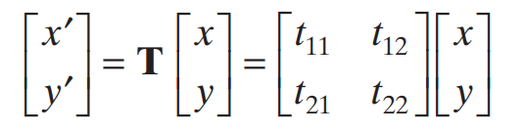
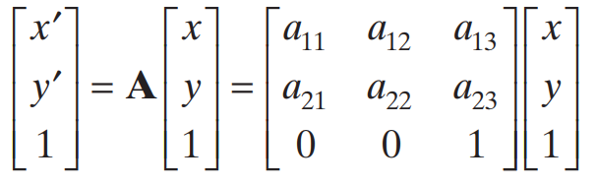
Geometric Spatial Transformations
Geometric transformation (rubber-sheet transformation)
— A spatial transformation of coordinates
— intensity interpolation that assigns intensity values to the spatially transformed pixels.
Affine transform

Slide 86
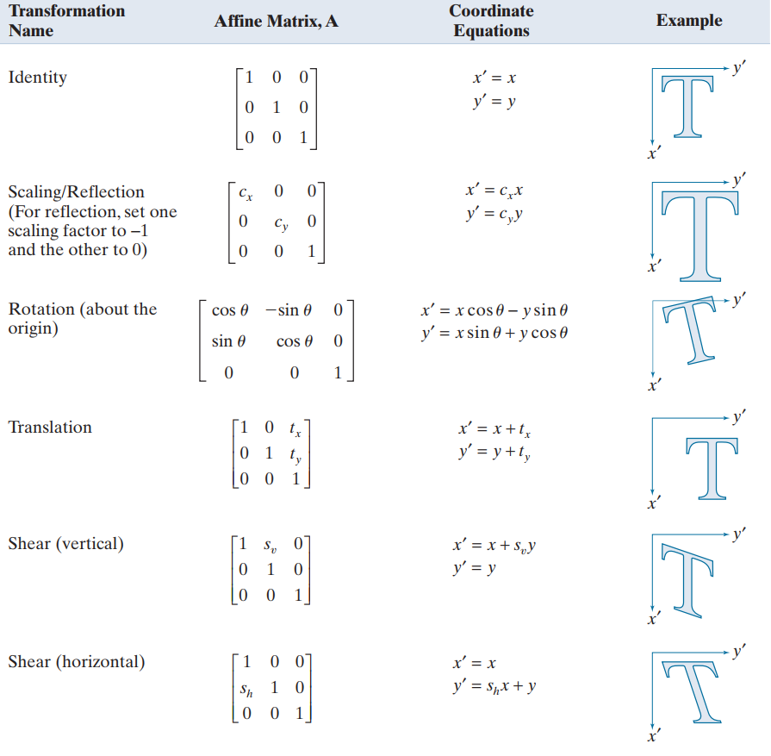

Slide 87
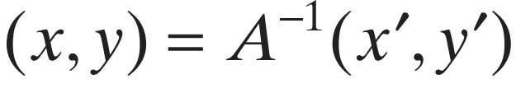
Intensity Assignment
Forward Mapping: scanning the pixels of the input image and, at each location ( x, y) computing the spatial location (x’ , y’)of the corresponding pixel in the output image
It’s possible that two or more pixels can be transformed to the same location in the output image.
Inverse Mapping
The nearest input pixels to determine the intensity of the output pixel value.
Inverse mappings are more efficient to implement than forward mappings.

Slide 88
Example: Image Rotation and Intensity Interpolation

Slide 89
Image Registration
Input and output images are available but the transformation function is unknown.
Goal: estimate the transformation function and use it to register the two images.
One of the principal approaches for image registration is to use tie points (also called control points)
The corresponding points are known precisely in the input and output (reference) images.

Slide 90
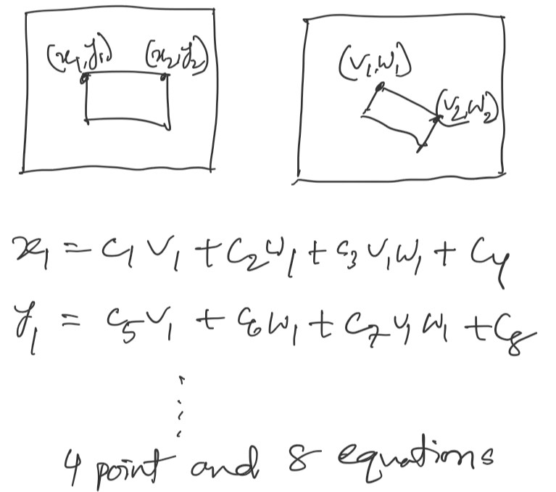

Slide 91
Image Registration
A simple model based on bilinear approximation:

Slide 92
Image Registration

Slide 93
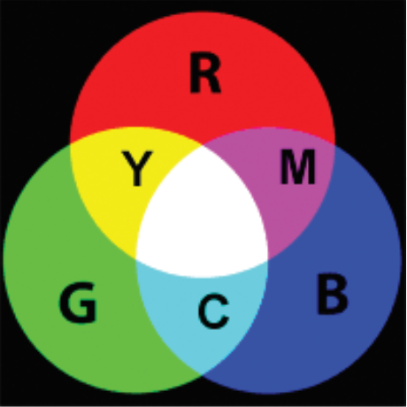
Color space: RGB
A color space is a specific organization of colors.
In combination with color profiling supported by various physical devices, it supports reproducible representations of color -- whether such representation entails an analog or a digital representation.

Slide 94
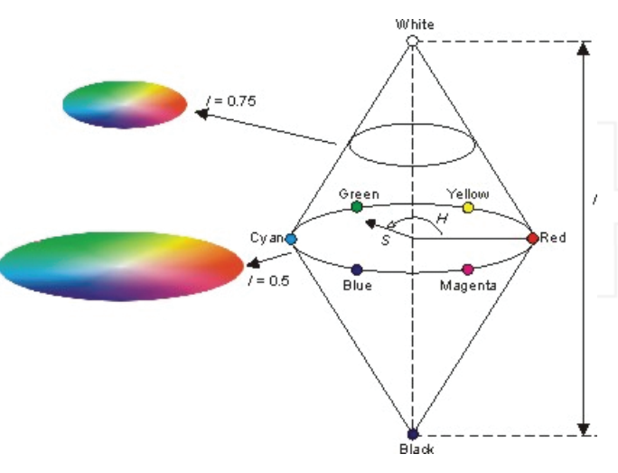
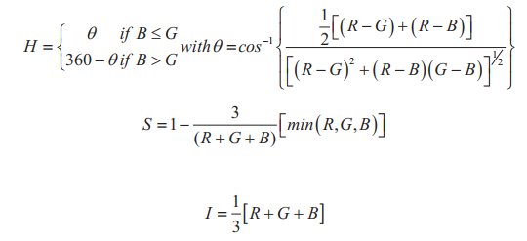
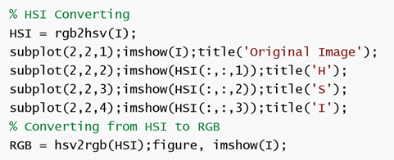
HSI Color space
The Hue, which can be defined rate of pure color, is an angle form between 0° and 360°. Red, Green, Blue are 0°, 120°, and 360°, and Yellow, Cyan, and Magenta are 60°, 180°, 300°.
The Saturation, which shows how the color to be pure, takes value between [0, 1].
The intensity is the dimensions of lightness or darkness. The range of intensity is between 0 (black) and 1 (white).

Slide 95
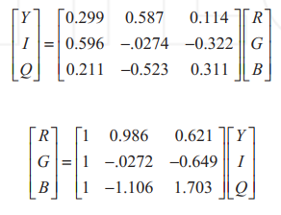

YIQ Color space
YIQ, which is defined by the National Television System Committee (NTSC), produces the luminance and the chrominance.
The Y component represents the luma information, and is the only component used by black-and-white television receivers. I and Q represent the chrominance information.

Slide 96
Noise
We may define noise to be any degradation in the image signal, caused by external disturbance.
If an image is being sent electronically from one place to another, via satellite or wireless transmission, or through networked cable, we may expect errors to occur in the image signal. These errors will appear on the image output in different ways depending on the type of disturbance in the signal.
Cleaning an image corrupted by noise is thus an important area of image restoration

Slide 97

Salt and pepper noise
Also called impulse noise, shot noise, or binary noise.
This degradation can be caused by sharp, sudden disturbances in the image signal; its appearance is randomly scattered white or black (or both) pixels over the image.

Slide 98

Gaussian noise
Gaussian noise is an idealized form of white noise, which is caused by random fluctuations in the signal.
We can observe white noise by watching a television which is slightly mistuned to a particular channel. Gaussian noise is white noise which is normally distributed.
If the image is represented as ‘I’ and the Gaussian noise, ‘N’ by then we can model a noisy image by simply adding the two:
noisy image = I + N

Slide 99

Speckle noise
Whereas Gaussian noise can be modelled by random values added to an image; speckle noise (or more simply just speckle) can be modelled by random values multiplied by pixel values, hence it is also called multiplicative noise.
noisy image = I (1+ N)

Slide 100

Periodic noise
If the image signal is subject to a periodic, rather than a random disturbance, we might obtain an image corrupted by periodic noise.
The effect is of bars over the image.

Slide 101


Noise cleaning/removal
Average filtering
Median filtering
Rank-order filtering
Rather than take the median of a set, we order the set and take the -th value, for some predetermined value of .
Outlier method
Image averaging

